Slide 1










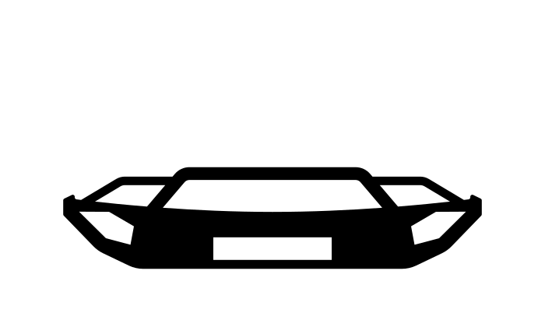


Delivering dismantled parts
Supplying dismantled vehicles
Bringing car to garage for repair or discard
Dismantlers
Garages
Supplying plastics for incineration
Supplying end-of-life vehicles
Supplying parts for car repairs
Users
Supplying downcycled plastics
Shredders & Post-shredders
Manufactured car is taken into use
Logistic companies
Selling parts
Providing blueprint for a car
Providing parts for new cars
Car manufacturers
Other industries
Supplying raw materials for parts manufacturing
PMs & OEMs
Miners & Refiners
Designers

